Slide 1

Bike Sharing Data Analysis Understanding Rider Behavior through Data Insights By Roshani Mor Date: 15th October 2025 An Analytical Study on Usage Patterns of Casual and Registered Riders

Slide 2
Contents
Introduction Project Objective Data Overview Methodology Casual vs Registered Riders Overview Daily Usage Pattern Weekend vs Weekday Analysis Weather Impact on Bike Usage Preferred Riding Conditions Holiday vs Non-Holiday Rides Hourly or Time-Based Trends Seasonal Trends Correlation between Temperature and Humidity Peak Usage Day Key Insights Dashboard Snapshot Recommendations Challenges Faced Conclusion

Slide 3

Introduction
The bike-sharing system provides a convenient, eco-friendly mode of transportation for riders. With the growing popularity of shared mobility, it becomes essential to understand user behavior, usage trends, and external factors influencing ride patterns.
This analysis explores how weather, temperature, weekdays, and holidays affect bike rentals among casual and registered users. By identifying these insights, we aim to improve operational efficiency, user satisfaction, and business strategy for bike-sharing platforms

Slide 4
Project Objective
The primary goal of this project is to analyze bike usage data to uncover meaningful patterns and insights that can support data-driven decision-making.
Key Objectives:
To compare ride behaviors of casual vs. registered riders.
To identify how weather and temperature affect overall ridership.
To determine which days and seasons record the highest and lowest usage.
To evaluate the impact of holidays and weekends on total rentals.
To visualize insights through interactive dashboards and charts for better interpretation.

Slide 5
Data Overview
Data Attributes Include:
Date and Season
Temperature, Humidity, and Weather Conditions
Rider Type (Casual or Registered)
Count of Total Rides per Day
Day of the Week and Holiday Indicator

Slide 6
Methodology & Approach
Data Cleaning & Preparation: Removed duplicates, handled missing values, and standardized column names.
Data Merging: Combined multiple datasets to form a single consolidated view.
Pivot Table Analysis: Explored relationships between variables such as weather, weekday, and user type.
Visualization: Created charts to highlight trends in user behavior, temperature patterns, and seasonal changes.
Dashboard Creation: Designed an interactive Excel dashboard summarizing the complete analysis.

Slide 7
Casual vs Registered Riders Overall Comparison
The analysis shows a clear distinction between casual and registered riders in terms of usage frequency, purpose, and timing. Registered Riders:
Use bikes consistently throughout the week. Primarily rely on the service for daily commuting. Show minimal fluctuation in ride count despite weather variations.
Casual Riders:
Prefer riding on weekends, holidays, and during good weather. Their riding behavior is seasonal and leisure-driven. Display sharp variations based on temperature and day type.
Observation: Registered riders contribute to a stable user base, whereas casual riders drive peak loads during weekends and favorable weather, creating an opportunity for dynamic resource planning

Slide 8
Daily Usage Pattern
How Riding Behavior Changes by Day The analysis of daily bike rentals revealed clear behavioral patterns across weekdays. Registered riders tend to use the service consistently throughout the week, primarily for commuting purposes. In contrast, casual riders show a sharp rise in activity on weekends, indicating more recreational usage. Highest usage: Saturday and Sunday Lowest usage: Monday Observation: Casual users prefer leisure rides during weekends, while registered users rely on weekday commutes.

Slide 9
Weekend vs. Weekday Analysis
Weekend vs. Weekday Usage Comparison When comparing total rides on weekends versus weekdays, weekends consistently show a higher count of casual rides, while registered rides remain steady. This highlights the difference between leisure-oriented and utility-oriented users.
Weekend total rides: Significantly higher for casual riders Weekday total rides: Dominated by registered riders
Insight: Marketing and promotions should target casual riders during weekends to maximize engagement.

Slide 10
Weather Impact on Bike Usage
Weather Conditions and Their Impact on Ride Volume Weather plays a crucial role in influencing ridership. Clear or mildly cloudy weather attracts the maximum number of rides, whereas poor weather such as heavy rain or fog drastically reduces both casual and registered user activity.
Ideal conditions: Clear weather with moderate temperature
Least favorable: Stormy or misty days Observation: Casual riders are more sensitive to weather changes compared to registered ones.

Slide 11
Preferred Riding Conditions
Most Preferred Temperature and Climate Range The data shows that most rides occur when the temperature is between 20°C and 25°C — a comfortable range for both casual and registered riders. Registered users maintain stable participation even outside this range, while casual riders drop significantly in extreme temperatures
Temperature sweet spot: 20°C – 25°C
Humidity preference: Moderate (40–60%) Key Takeaway: Pleasant, dry weather conditions boost overall rentals.

Slide 12
Holiday vs. Non-Holiday Rides
Riding Behavior on Holidays vs. Regular Days Holidays significantly impact ridership patterns. Casual riders show a dramatic increase during festive and public holidays, while registered users display minimal variation. This suggests that casual riders primarily associate biking with leisure and free time.
Casual rider increase: +30% to +40% on holidays
Registered rider stability: Marginal change observed Insight: Special holiday offers or extended rental hours could increase platform usage further.

Slide 13
Seasonal Trends
Seasonal Variation in Bike Usage
The overall ride count varies noticeably across seasons. Summer and autumn record the highest number of rides due to favorable weather and longer daylight hours. Conversely, winter and monsoon seasons show a decline in total ridership due to cold or wet conditions
Peak season: Summer and Autumn
Off-peak: Winter and Rainy season
Conclusion: Seasonality must be considered while planning fleet distribution and promotional campaigns.

Slide 14
Correlation between Temperature and Humidity
How Temperature and Humidity Influence Rides
An interesting correlation is observed between temperature, humidity, and the number of rides. As temperature increases up to a certain point, the number of rides also increases. However, when humidity levels exceed 70%, total rides start to decline, irrespective of temperature.
Optimal humidity range: 40% – 65%
Extreme humidity (>70%) reduces ride count
Insight: Mildly warm and dry conditions drive higher user engagement.

Slide 15
Correlation between Temperature and Humidity
How Temperature and Humidity Influence Rides
Optimal humidity range: 40% – 65%
Extreme humidity (>70%) reduces ride count
Insight: Mildly warm and dry conditions drive higher user engagement.

Slide 16

Peak Usage Day
Identifying the Peak Usage Day
The dataset highlights Saturday as the peak usage day across all user types. Casual riders dominate during this period, accounting for nearly 60–65% of total rides. This reaffirms the trend of weekend-based recreational riding behavior.
Top day: Saturday
Peak hour : Late afternoon to evening
Inference: Increasing bike availability on weekends could reduce service shortages.

Slide 17
Key Insights
Consolidated Insights from the Analysis
Registered riders use bikes primarily for daily commuting.
Casual riders prefer weekends, holidays, and good weather conditions
Clear, mild days with moderate temperature see the highest rental activity.
Seasonal variation shows summer as the most active period.
Peak traffic occurs on Saturdays and Sundays.
Strategic resource allocation can optimize availability and revenue.

Slide 18
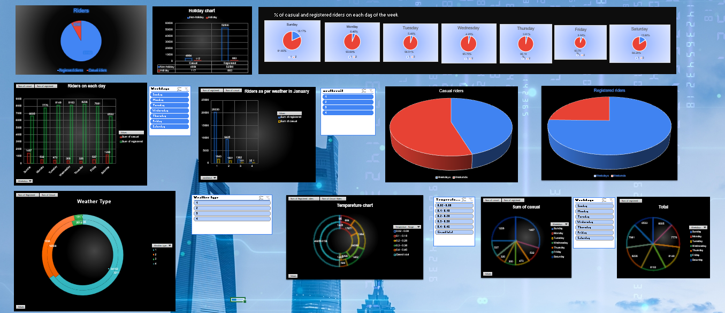
Dashboard Snapshot
Key Highlights:
% of casual vs. registered riders per day
Weekday vs. Weekend utilization
Temperature and weather-wise segmentation
Holiday impact visualization

Slide 19
Recommendations
Strategic Recommendations Based on Findings
Increase Weekend Availability: Deploy more bikes and service staff on weekends to meet casual rider demand.
Targeted Marketing: Launch weather-based and holiday-specific promotions for casual users.
Subscription Retention: Offer loyalty rewards for registered users to maintain weekday engagement.
Seasonal Adjustments: Increase fleet during summer months; optimize maintenance during off-peak seasons.
Data Automation: Implement predictive modeling for demand forecasting and real-time analytics.

Slide 20
Conclusion
The bike-sharing analysis reveals that user behavior is deeply shaped by time, weather, and purpose. While registered riders demonstrate reliability and consistency, using bikes for their daily commute, casual riders bring vibrancy and spikes in demand during weekends, holidays, and pleasant weather.
Key Highlights:
Ride volume rises sharply during weekends and clear-weather days.
Registered riders ensure a consistent weekday base load
Seasonal trends confirm that summer and autumn remain peak periods for engagement.
Understanding these behavioral patterns enables better fleet management and promotional targeting

Slide 21

Thank you
Roshani Mor
Link to the File: https://d.docs.live.net/136AD9D37017EA8A/Documents/Complete%20project.xlsx

